Slide 1


Gujarat University﻿
School of Emerging Science and Technology ﻿
Ahmedabad – Mumbai High Speed Rail Project
Name: Abhijeet Routh
Sem – 6 (AIML-29)
Enrollment No.: 202222700023
Name: Daivik Raval
Sem – 6 (AIML-28)
Enrollment No.: 202222700038
Mentors :- Dr Akash Singh and Mr Gautam Chauhan

Slide 2
Abstract
This study present a PERT and CPM model which approach to manage the construction. While addressing the key constraints of construction are its resource limitation while construction which are Raw material availability : Steel , sand and gravel , cement and concrete Energy resources : Electricity supply , fuel for construction The model contains 12 different station which is long with approximately of 508 km.

Slide 3
Abstract
Thus to build the path various kind of materials are required which delay due to seasonal conditions like rain and fog a model has been carried out to show much days delay it will take to supply material and work will be started. Jupyter notebook software is used to analyze the result of this pert and cpm model.

Slide 4
Introduction
The Ahmedabad - Mumbai High Speed Rail Project (AMHSR), popularly known as the Bullet Train Project, will introduce the first-ever bullet train to operate in India.
The train will run between Ahmedabad city and Mumbai, covering about 500 km (310 miles).

Slide 5
Introduction
The AMHSR corridor will include 8 mountain tunnels, which will be constructed using the New Austrian Tunneling Method (NATM).
Seven of these tunnels are located in the Palghar district of Maharashtra, while one is situated in the Valsad district of Gujarat.

Slide 6
Objective
Engage Stakeholders: Inform government officials, investors, and the general public about the project’s potential to transform the transportation landscape between Ahmedabad and Mumbai, and encourage collaboration and support.
Encourage Public Support and Awareness: Raise awareness about the long-term benefits of the bullet train and encourage community engagement and support for the project.

Slide 7
Constraints
Funding Sources: The project is being financed through a mix of Indian government funds, Japanese loans, and private sector contributions.
Land Acquisition & Relocation: The construction of the bullet train line will require significant land acquisition, displacing individuals and businesses, leading to possible protests and legal challenges.

Slide 8
Review of literature
In order to construct a PERT-CPM model, a thorough review of existing studies and methodologies is required.
PERT in Construction Management: PERT has been widely applied in large-scale infrastructure projects, especially those involving significant uncertainty in task durations (e.g., public consultations or weather delays).

Slide 9
Review of literature
CPM for Large-Scale Infrastructure Projects: CPM has been utilized in construction projects to determine the critical path the longest sequence of tasks that dictates the overall project duration.
Impact of Weather Conditions: Several studies have focused on incorporating environmental constraints like weather into construction timelines.

Slide 10
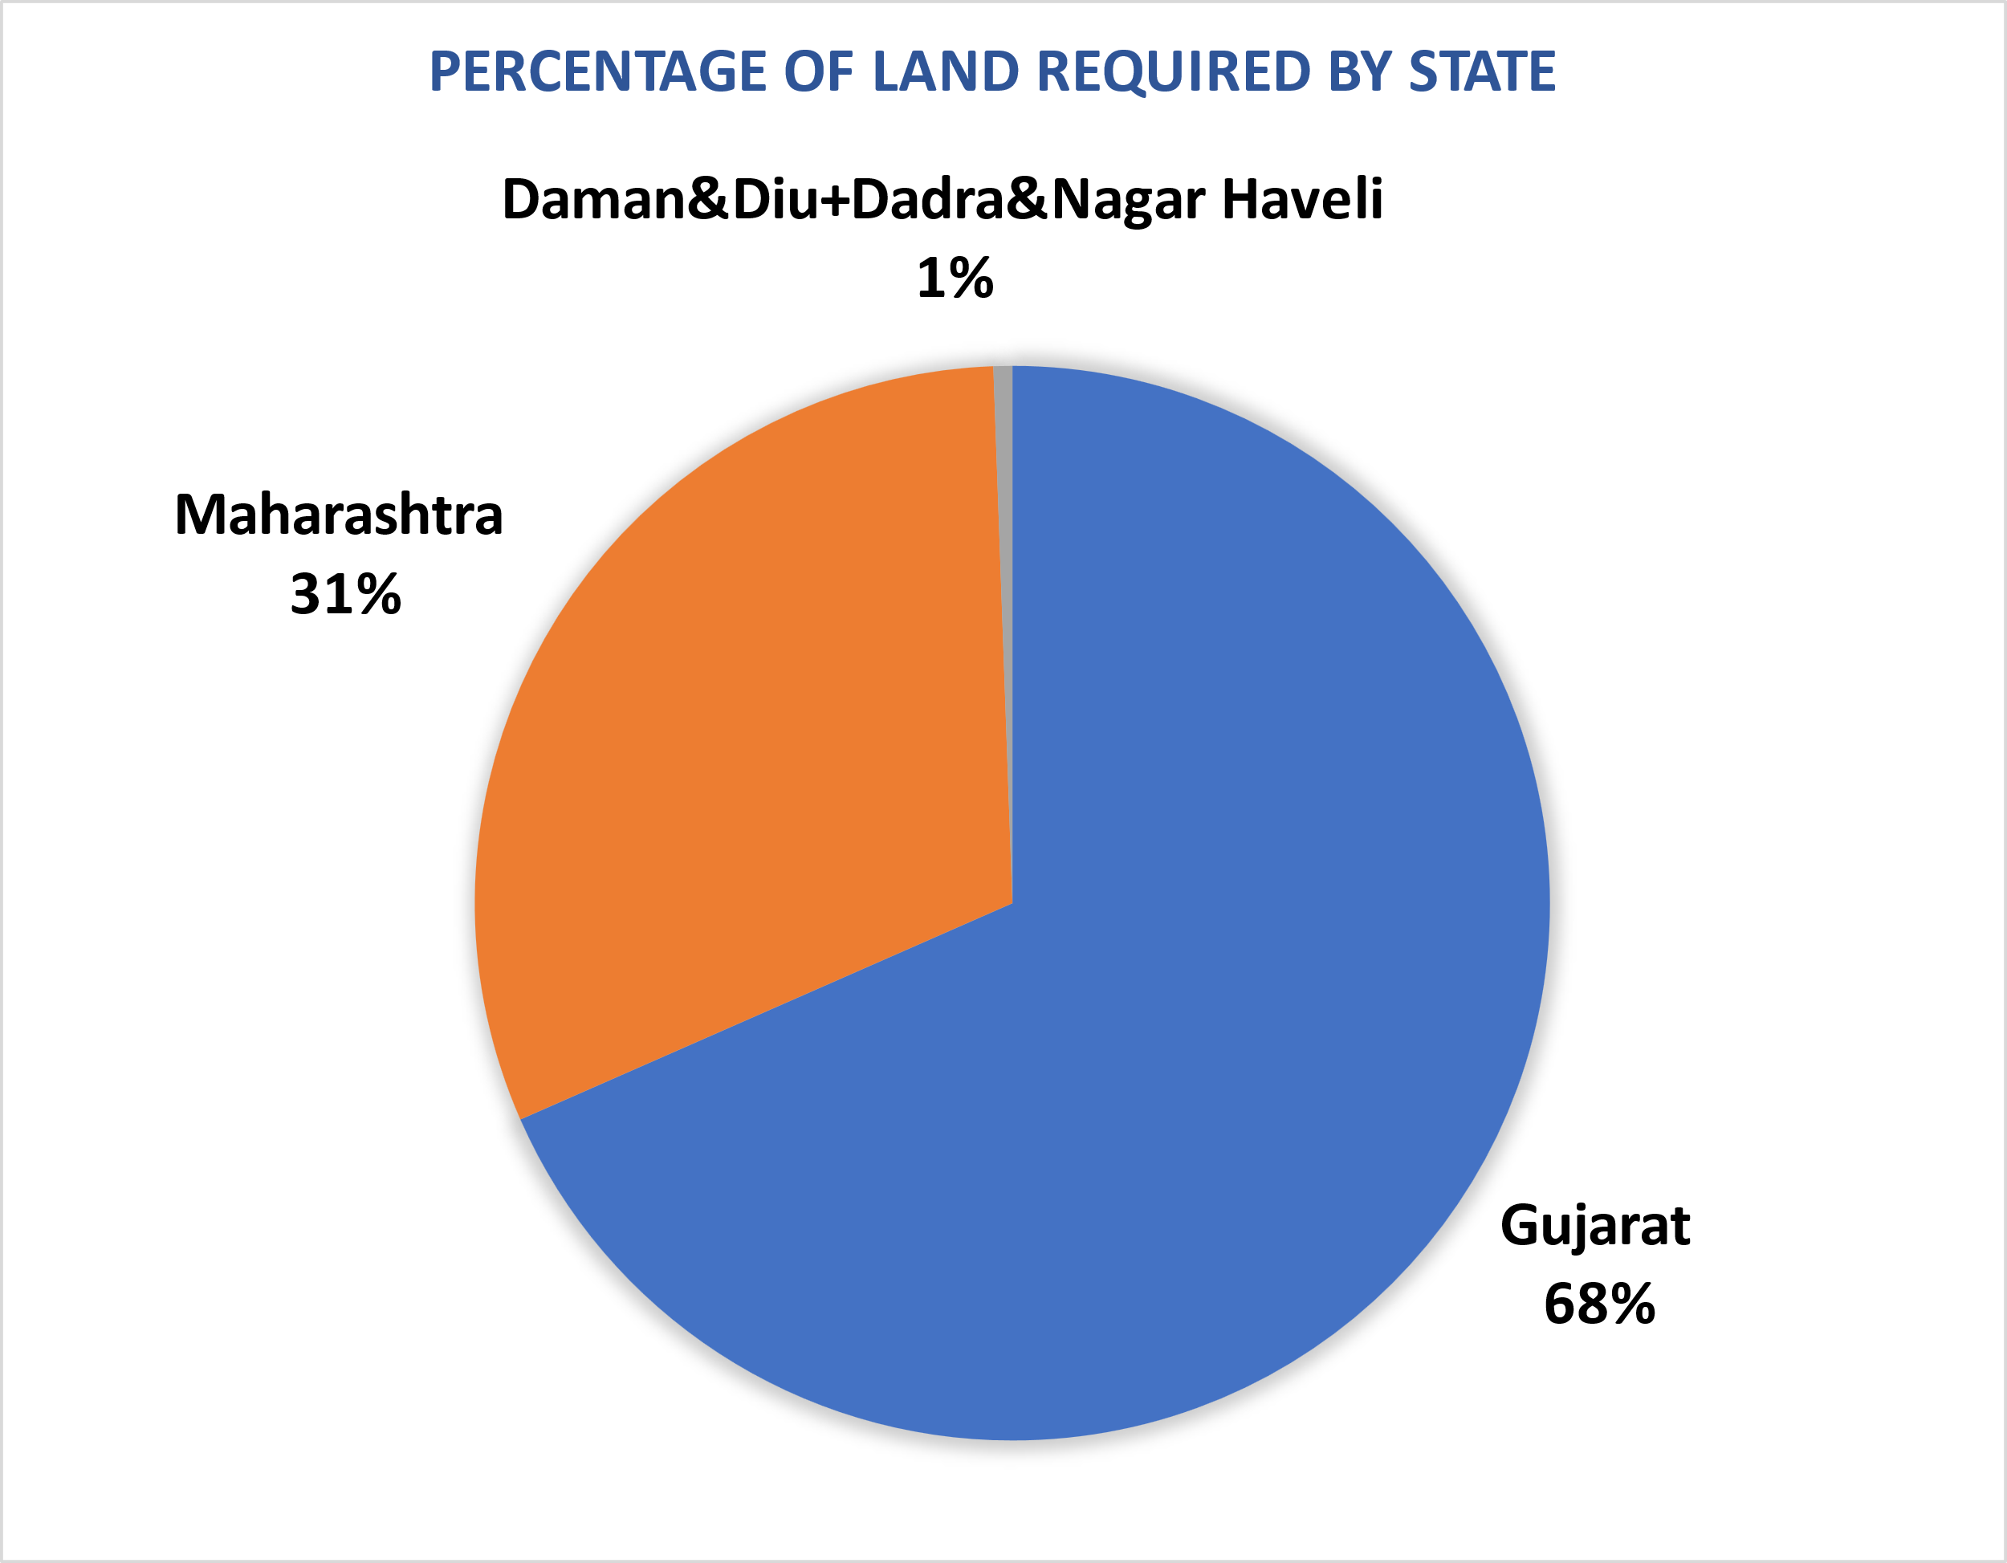
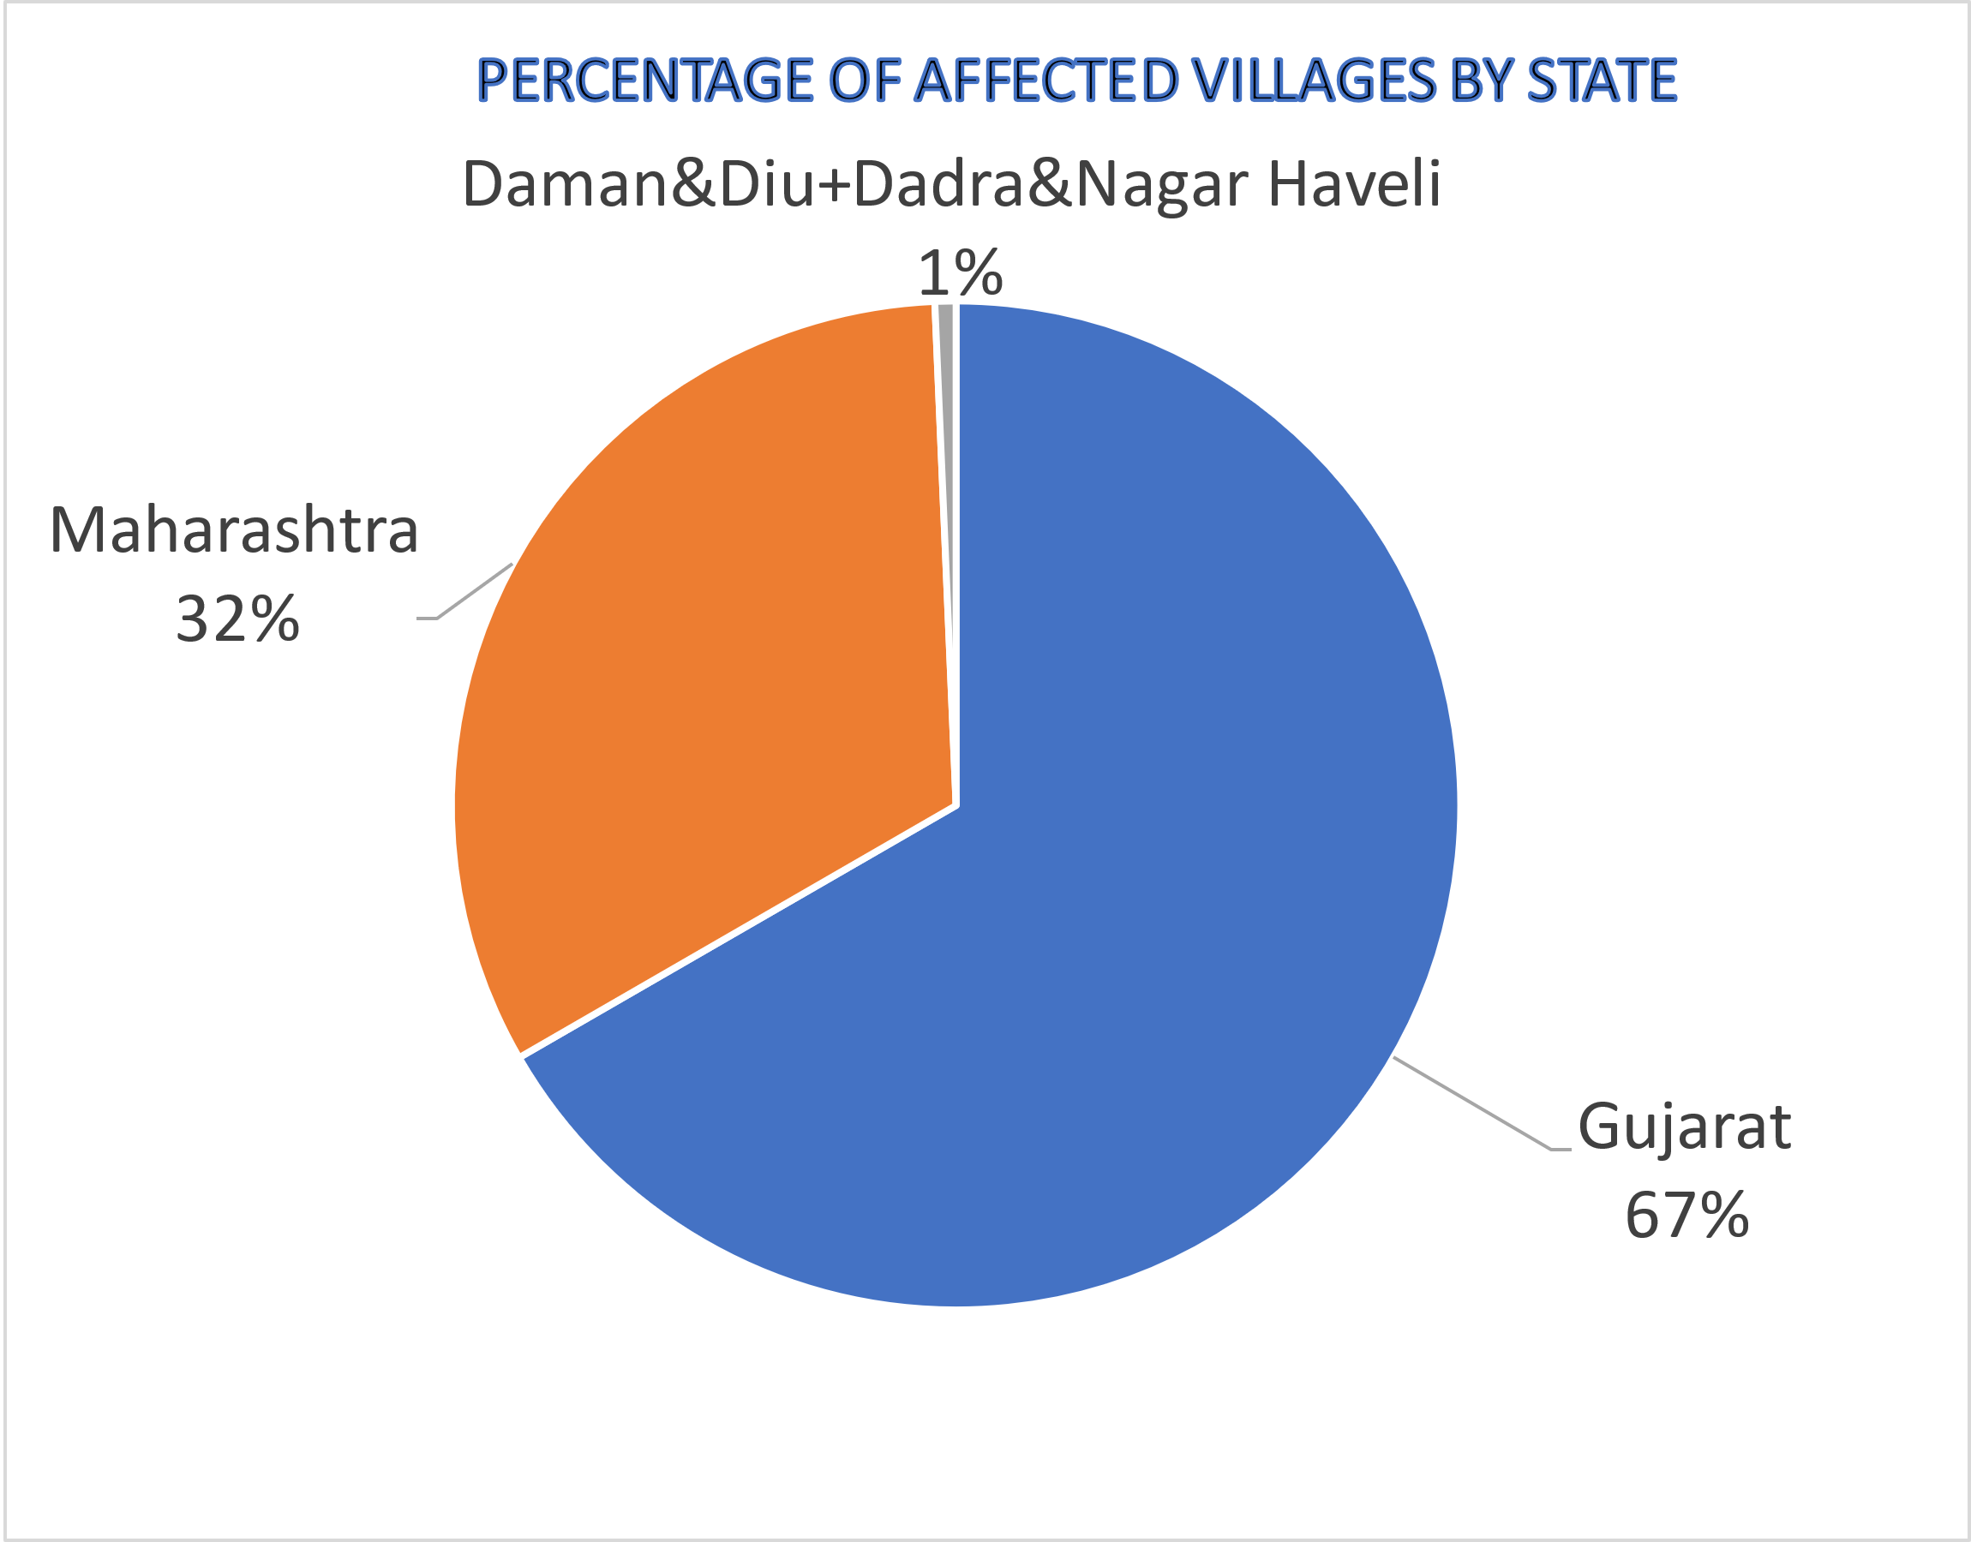
Land Acquisition Status For Bullet Train Project

Slide 11
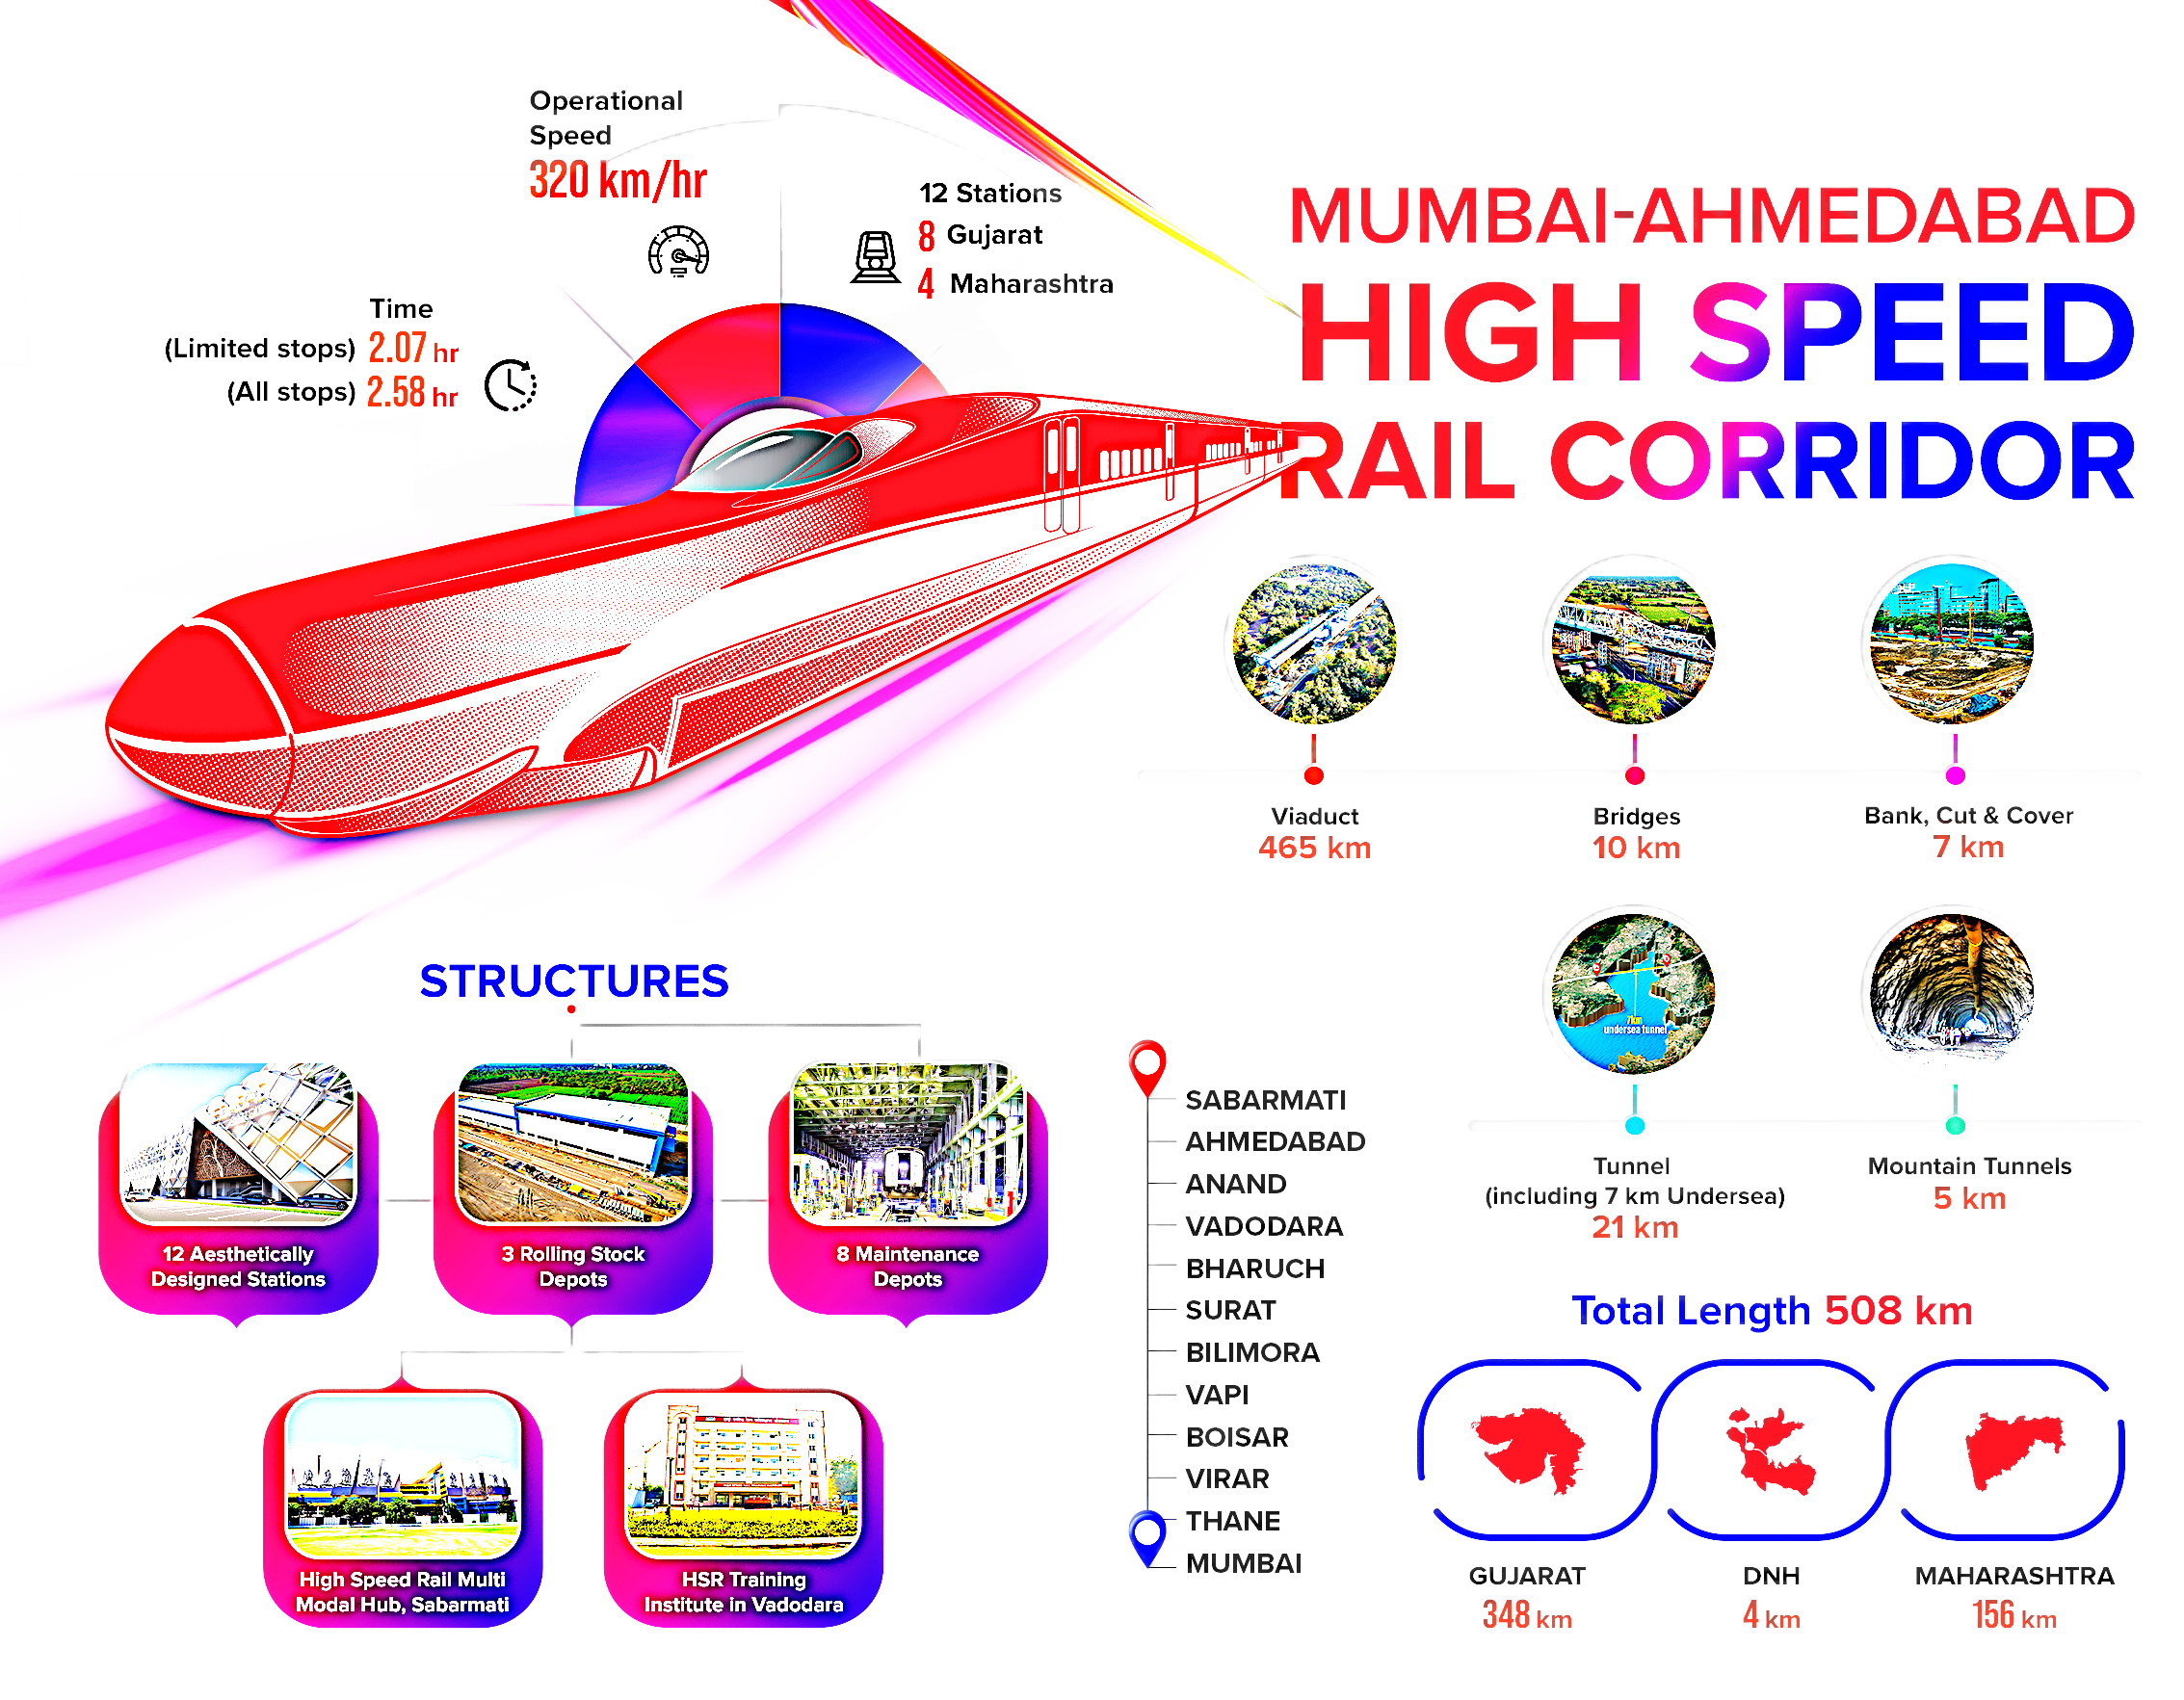

Slide 12
Methodology
This project is an implementation of the PERT (Program Evaluation and Review Technique) and CPM (Critical Path Method) for project management, extended to incorporate resource constraints.

Slide 13
Methodology
1. Data Preparation:
Task Data: The project loads the task data from a CSV file (task_data.csv) containing information about tasks such as:
Task ID
Task Name
Predecessor Tasks

Slide 14
  Methodology
Resource Constraints Data: The project loads another CSV file (resource_constraints.csv) which contains information about:
Task ID
Seasonal Delays
Weather Impact on Task Duration

Slide 15
Methodology
2. Expected Duration Calculation:
Expected Duration Calculation for PERT: The project calculates the expected task durations using the PERT formula:
task_data_cleaned['Expected Duration (seconds)']=( task_data_cleaned['Optimistic Duration (second)'] + 4 * task_data_cleaned['Most Likely Duration (second)'] + task_data_cleaned['Pessimistic Duration (second)'] ) / 6 task_data_cleaned['Expected Duration (minutes)'] =
task_data_cleaned['Expected Duration (seconds)'] / 60

Slide 16
Methodology
3. Graph Construction for Task Dependencies (PERT/CPM Network):
A directed graph (DiGraph) is created to represent the task dependencies.
Nodes: Each task is added as a node in the graph.
Edges: Dependencies between tasks are captured as edges.

Slide 17
Methodology
4. Critical Path Calculation (PERT/CPM):
Critical Path: The critical path of the project is calculated using nx.dag_longest_path(), which finds the path through the task network that takes the longest time to complete.
Critical Path Length: The length of the critical path is also calculated by summing the weights (durations) of the edges in the critical path.

Slide 18
Methodology
5. Graph Visualization:
Node Labels: Each node (task) is labeled with the task name.
Edge Labels: The expected duration of each task is displayed on the edges between tasks.
Critical Path: The edges in the critical path are highlighted in red.

Slide 19
Methodology
6. Displaying Task Data:
After the PERT/CPM analysis, a Task Data Table is displayed showing the task ID, task name, and expected duration (in minutes).
7. Resource Constraints Analysis:
Graph for Resource Constraints: A second directed graph is created to represent resource constraints on each task.

Slide 20
Methodology
The nodes in this graph represent tasks, and additional information about delays (weather impact, seasonal delays, and constraint type) is added to the node attributes.

Slide 21
Methodology
8. Displaying Resource Constraints Data:
The resource constraints are also displayed in a table, showing for each task:
Seasonal delays
Weather impact on duration
Constraint type

Slide 22
Methodology
9. Visual Outputs:
Two visual outputs are generated:
Graph 1 (PERT-CPM Network): Displays the task dependencies, critical path, and task durations.
Graph 2 (Resource Constraints Network): Displays the impact of resource constraints on the tasks.

Slide 23
Methodology
10. Summary:
After visualizing the graphs, the project provides a detailed summary:
The Critical Path of the project is displayed as a sequence of tasks.
The Critical Path Length (in minutes) is shown, indicating the total project duration.
A Task Data Table lists all tasks along with their expected durations.
A Resource Constraints Table provides detailed information about resource-related delays and constraints.

Slide 24
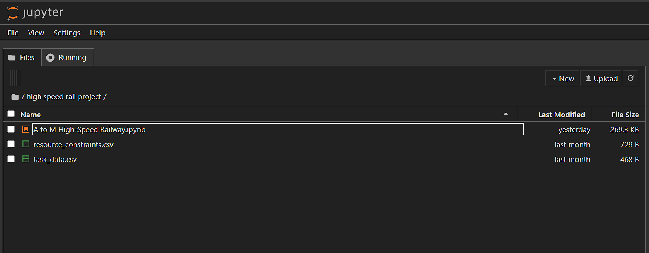
Methodology
File structure:

Slide 25
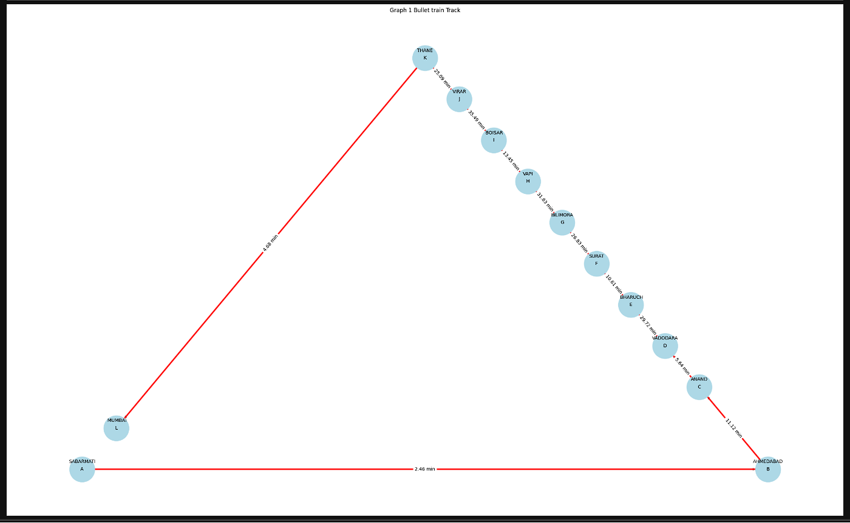
OUTPUT

Slide 26
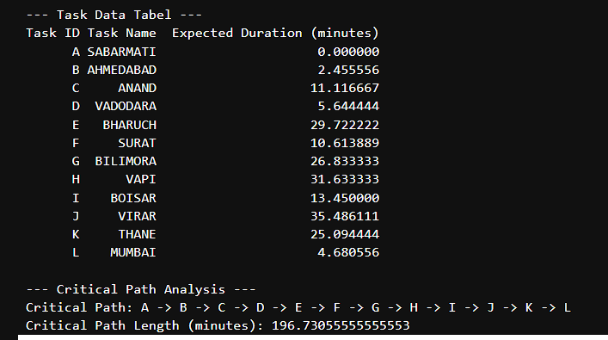

Slide 27
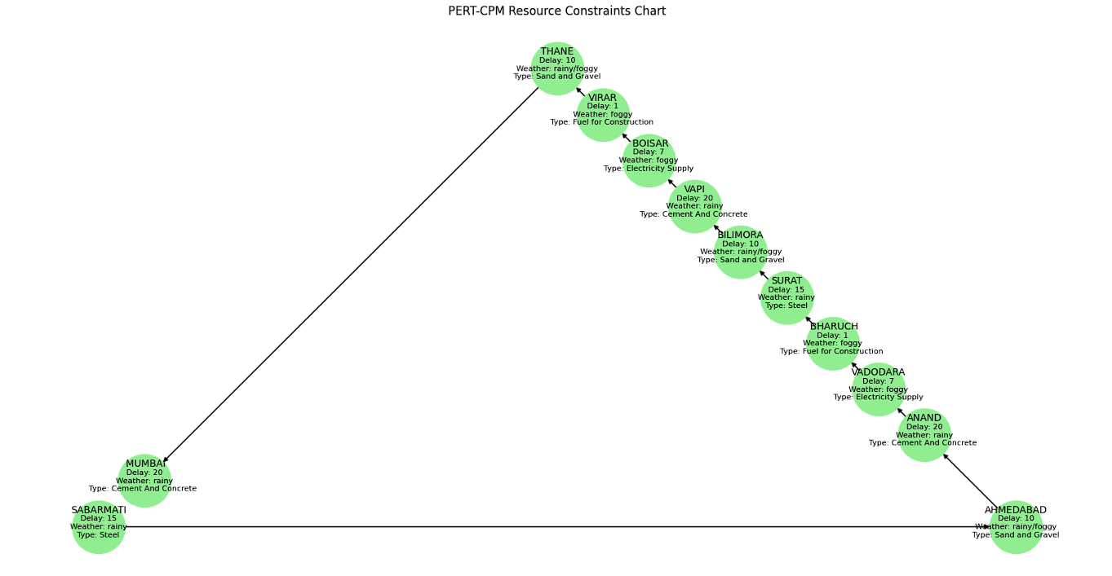

Slide 28
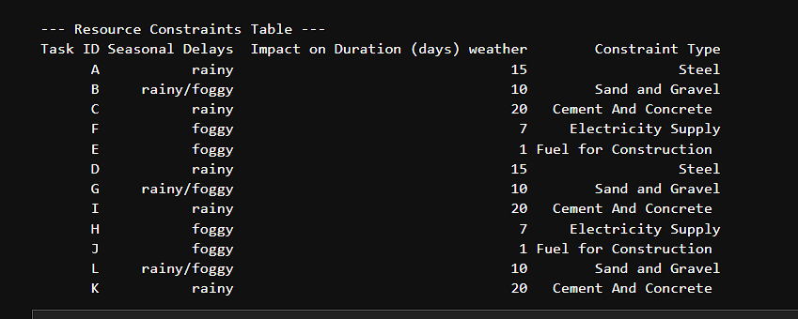

Slide 29
CONCLUSION
This project provides a clear, structured approach to analyzing project tasks and constraints, visualizing dependencies, and identifying critical path.
The graphical representation allows for easy identification of potential bottlenecks or risks in the project timeline due to resource constraints, enabling better decision-making in project planning and management.

Slide 30
REFERENCES
1. Kerzner, H. (2017). Project Management: A Systems Approach to Planning, Scheduling, and Controlling. John Wiley & Sons.
2. Williams, T. (2016). Managing Project Risks and Uncertainty. Wiley-Blackwell.

